Slide 1
Performance Evaluation Strategies

Slide 2
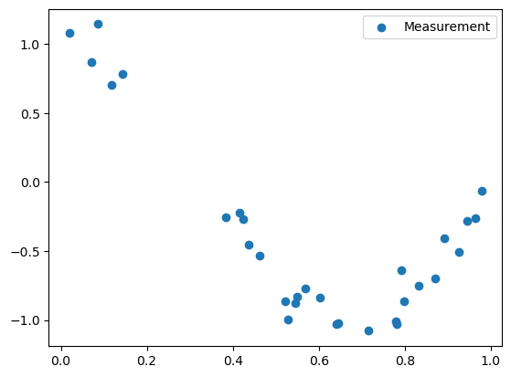
Overfitting
Some Measurements
X is our feature
Y is what we want to predict
Train a model that predicts Y

Slide 3
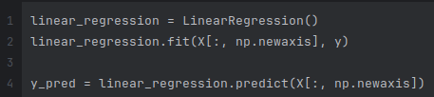

Overfitting
Linear model
Some regression performance metrics

Slide 4
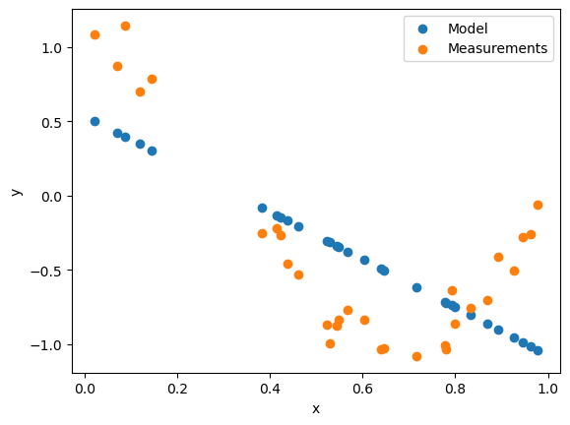
Overfitting
Linear model
…sucks
MAE = 0.42
MSE = 0.23
R2 = 0.47

Slide 5
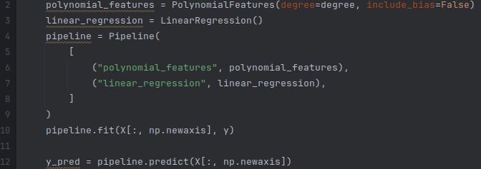
Overfitting
More complex model!

Slide 6
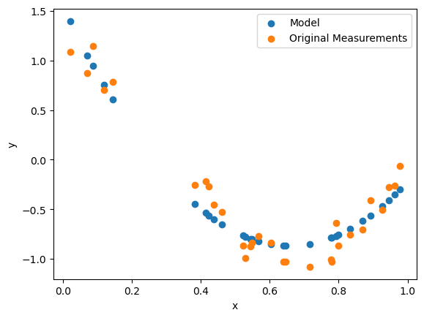
Overfitting
Polynomial Features
Degree 2
MAE = 0.15
MSE = 0.03
R2 = 0.93

Slide 7
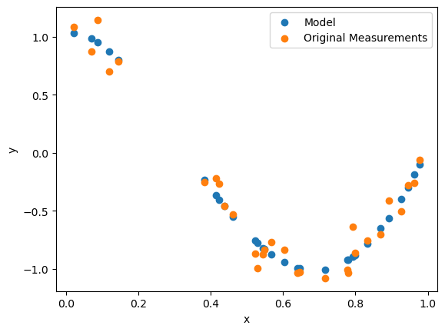
Overfitting
Polynomial Features
Degree 4
MAE = 0.08
MSE = 0.01
R2 = 0.97

Slide 8
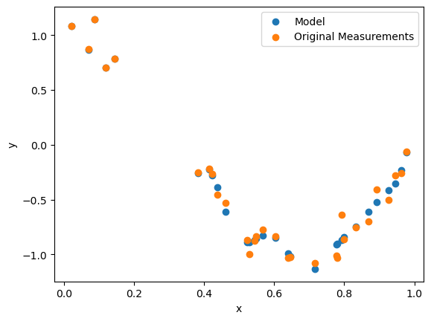
Overfitting
Polynomial Features
Degree 16
MAE = 0.05
MSE = 0.00
R2 = 0.99

Slide 9
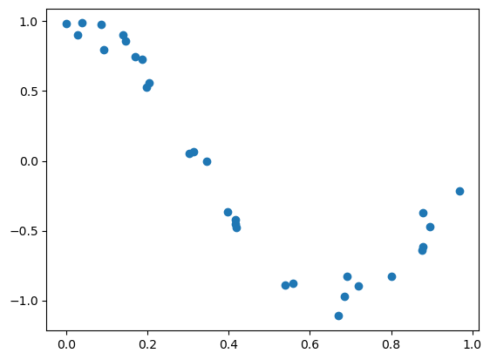
Overfitting
Reality
We get new measurements

Slide 10
Overfitting
Reality
We get new measurements

Slide 11
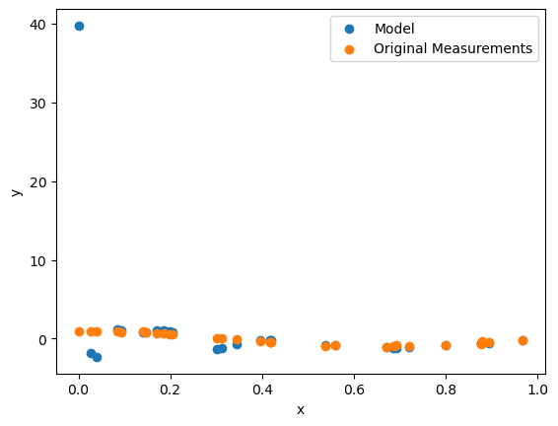
Overfitting
Our best model from before
MAE = 1.74
MSE = 50.83
R2 = -98.13

Slide 12
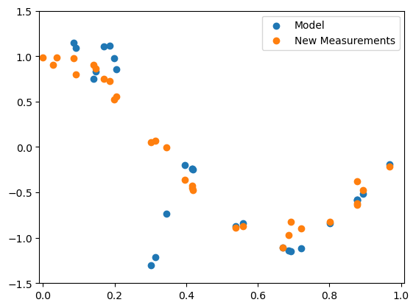
Overfitting
Our best model from before
Zoom in a bit
MAE = 1.74
MSE = 50.83
R2 = -98.13

Slide 13
Overfitting
Our best model from before
Zoom in a bit
MAE = 1.74
MSE = 50.83
R2 = -98.13

Slide 14
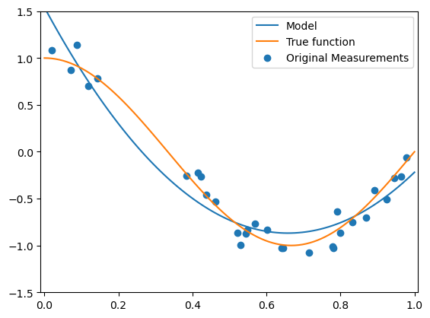
Overfitting
What we normally can't see
The function we learned
The function we wanted
Polynomial features
Degree 2

Slide 15
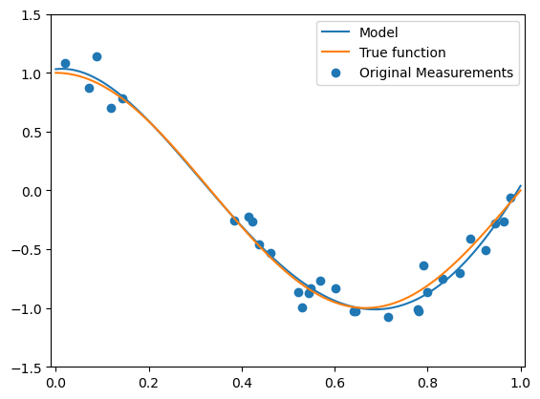
Overfitting
What we normally can't see
The function we learned
The function we wanted
Polynomial features
Degree 4

Slide 16
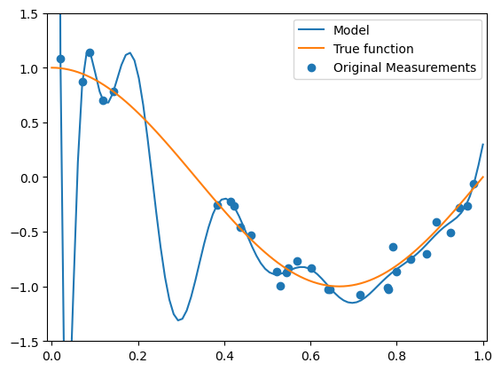
Overfitting
What we normally can't see
The function we learned
The function we wanted
Polynomial features
Degree 16

Slide 17
More problems

Slide 18
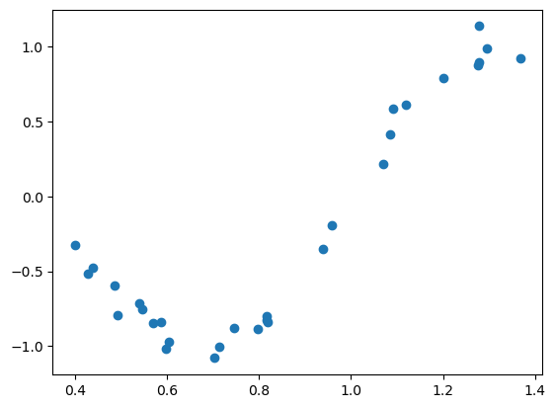
Out of distribution
Again, reality
We get new measurements
They go beyond the values found in the training set

Slide 19
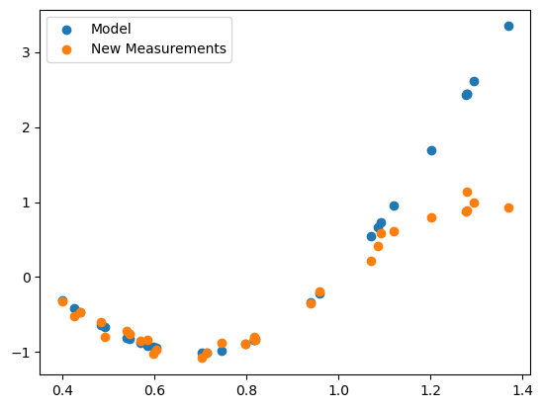
Out of distribution
Best model we saw in our Vizualisation above
Polynomial features
Degree 4
MAE = 0.38
MSE = 0.54
R2 = 0.01

Slide 20
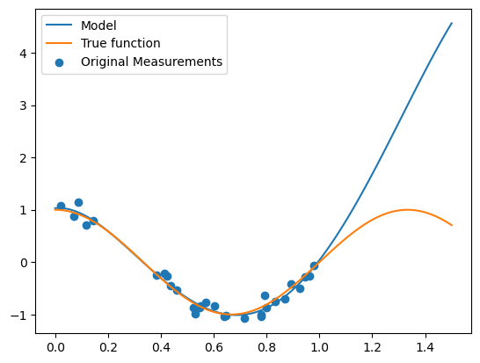
Out of distribution
What we normally can't see
The function we learned
The function we wanted
Polynomial features
Degree 4

Slide 21
Ideas on how to measure model performance

Slide 22
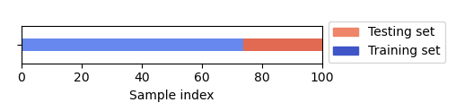
Train-Test Split
Split the whole dataset
Train on one part
Evaluate on the other

Slide 23
Train-Test Split - Problems

Slide 24
Train-Test Split - Problems
Order
cats
dogs

Slide 25
Train-Test Split - Problems
Order
Housing prices

Slide 26
Train-Test Split - Problems
Order
Solution: Shuffle before splitting!

Slide 27
Train-Test Split - Problems
Order
Solution: Shuffle before splitting!
unless … Timeseries data! (more on that later)

Slide 28
Train-Test Split - Problems
Produces a single evaluation score
Maybe test set ended up being “easy” by chance?

Slide 29
Ideas on how to get more confident in results?

Slide 30
Repeated shuffled train test split
Repeat the shuffling and train test splitting?
Provides more performance measurements.

Slide 31
Repeated shuffled train test split - Problems
Some data may never be in the test set
Some data may end up in multiple test sets
Strong overlaps possible
Problematic for statistical significance testing
Computationally expensive
(Not useful for timeseries data)

Slide 32
Better Ideas on how to get more confident in results?

Slide 33
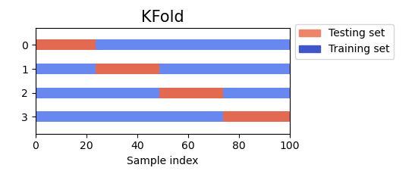
k-Fold Cross Validation
Split the whole dataset in k chunks
Train on n-1 parts
Evaluate on the one leftover
Repeat n times

Slide 34
k-Fold Cross Validation
Produces k scores
Widely applied in practice
Allows for limited statistical significance testing
If performance scores vary a lot
Model has problems
Something going on in the dataset

Slide 35
k-Fold Cross Validation - Problems
Only k scores
Actually allows only for very limited statistical significance testing
Not useful for time series data
Same problems with order as before

Slide 36
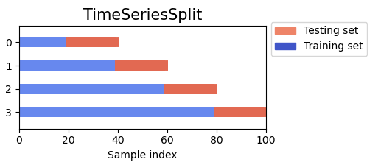
Time Series k-Fold Cross Validation
Train on first fold, evaluate on the second
Train on first two folds, evaluate on the third
…

Slide 37
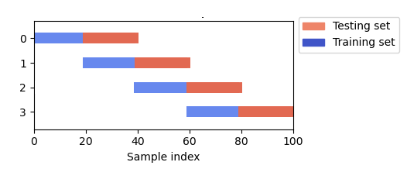
Blocked Time Series k-Fold Cross Validation
Train on first fold, evaluate on the second
Train on second fold, evaluate on the third
…

Slide 38
(Blocked) Time Series k-Fold Cross Validation - Problems
Requires a lot more data than regular k-Fold CV
Only k scores
Allows only for very limited statistical significance testing

Slide 39
Ideas how to produce more performance measurements?

Slide 40
Bootstrap (applied to ML context)
(Many variations, this is just one of them)
Repeated train-test split
Using resampling with replacement
N times
Resampling with replacement
Items are randomly selected
But put back in the sample space
The same item can be picked multiple times

Slide 41
Bootstrap (applied to ML context)
Produces N scores
Works well for small datasets
Allows some statistical significance testing

Slide 42
Bootstrap (applied to ML context) - Problems
Computationally expensive
Allows only for limited statistical significance testing

Slide 43
Notes on Statistical Significance Testing
We have a null hypothesis
E.g. H0 = Model A performs better than Model B
We want a p-value
Probability that we see our H0 true on our data by chance
Significance != Effect size

Slide 44
Parametric Tests
Student's t-test, z-test, wald-test

Slide 45
Parametric Tests - Student’s t-test - Assumptions
Student's t-test
Values come from normal distribution (do they?)
Values have similar variance
Values are independent (are they?)

Slide 46
Parametric Tests - Student’s t-test (don'ts)
Student's t-test
Model comparison example
K scores from each model (e.g. from k-fold CV)
Treat each as random collection

Slide 47
Parametric Tests - Student’s t-test (do)
Pairwise Student's t-test
Model comparison example
K scores from each model (e.g. from k-fold CV)
Test for normal distribution first
Tests the difference of those K scores
Be honest on the downsides and issues using student’s t-test
Evaluate effect size

Slide 48
Non-Parametric Tests
Sampling free
Sign test
Wilcoxon signed rank
Mann-Whitney u-test
…
Little statistical “power” but easy and cheap to apply
Sampling based
(paired) Bootstrap
Randomization test
…
Stronger, but computationally expensive

Slide 49
Take away message
Use at least k-fold CV unless you have a huge test set
Be aware of information leakage
Use time series splits whenever your data contains causal effects
Random repetition does not increase the statistical power
Use student’s t-test with caution
Try Bootstrap if theres little data (small data set)
There is no one golden bullet for statistical signifiance testing

